Slide 1
Lead Contamination in Bell Hill: Known and Unknown
Shane Capra

Slide 2
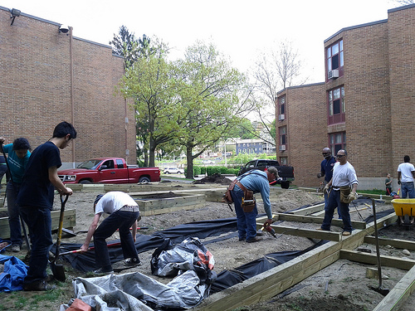
Lead in the Soil- OH NOES
Project to visually depict data collected by YIC!
YIC! Is a youth lead environmental justice cooperative that focuses on lead issues in the Bell Hill Area.
Lead has contaminated soil through lead paint, leaded gasoline, and manufacturing.
YIC does free lead soil testing and remediation landscaping.

Slide 3
Research Objectives
To map the unorganized soil testing data YIC! has archived over the last 4 years
To monitor overall trends in Bell Hill soil samples
- which streets have the highest concentrations? The lowest?
A major source of contamination is from leaded gasoline which contaminates areas nearby roads and highways.
Mapping zones of predicted gas contamination will give YIC a better sense of sources of local contamination and where we should target our future testing

Slide 4
Where are the areas predicted to be contaminated by leaded gasoline?
Do they correlate with the actual tested levels of Pb?

Slide 5
Study Area Bell Hill

Slide 6
Data Sources!
Name | Format | Source | Date Created | Organization
“Contamination of Roadside Soil, Plants, and Air With Heavy Metals in Jordan, A Comparative Study” | Contamination range Data | Qasem M. Jaradat and Kamal A. Momani | 05/01/1998 | Chemistry Department, Mu'tah University, Al-Karak JORDAN
Census2010TigerRoads_Arc | Vector Line | MassGIS | 4/17/2012 | Office of Geographic Information
gismapping_GISDATA_Basemap_Parcels_Polygons | Vector Polygon | MassGIS | 4/17/2012 | Office of Geographic Information
gismapping_GISDATA_Basemap_Parcels_Addresses | Vector Point | MassGIS | 4/17/2012 | Office of Geographic Information
Testing Results | Text/integer tables | Youth in Charge! Archives | 2007 | Youth In Charge!

Slide 7
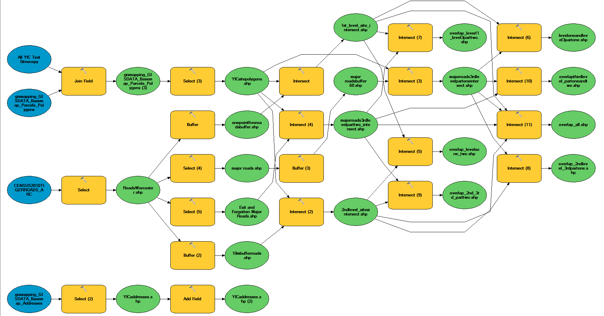
Macro Model

Slide 8
Methods: Known Contamination
1. Select by attribute to isolate roads, streets, and addresses in Bell Hill from TigerRoads and Census Data
2. Add ‘Total PPM’ field to address point data- use edit to insert YIC lead levels data
3. Join by attribute Site data to Census Parcel Polygons- select by SQL Total PPM >0

Slide 9
Methods!
4. Use graduated colors classified by UMass indicated danger levels to get a contamination map
5. Use a graduated breakdown of 0-399 and 400+ to create a dangerous sites map

Slide 10
Methods: Predicted Contamination
1. Buffer of 1.5 and then 10 meters on all of the roads
2. Select major roads only- performing a buffer of 60 meters
3. Run intersect with each of these buffers on the Site polygons- and then run intersect between the buffers to find overlaps
4. Graduate the intersecting areas to obtain a map of areas most likely to be gasoline contaminated

Slide 11
Results

Slide 13
Highway Overpasses, Exits, and Ramps

Slide 14
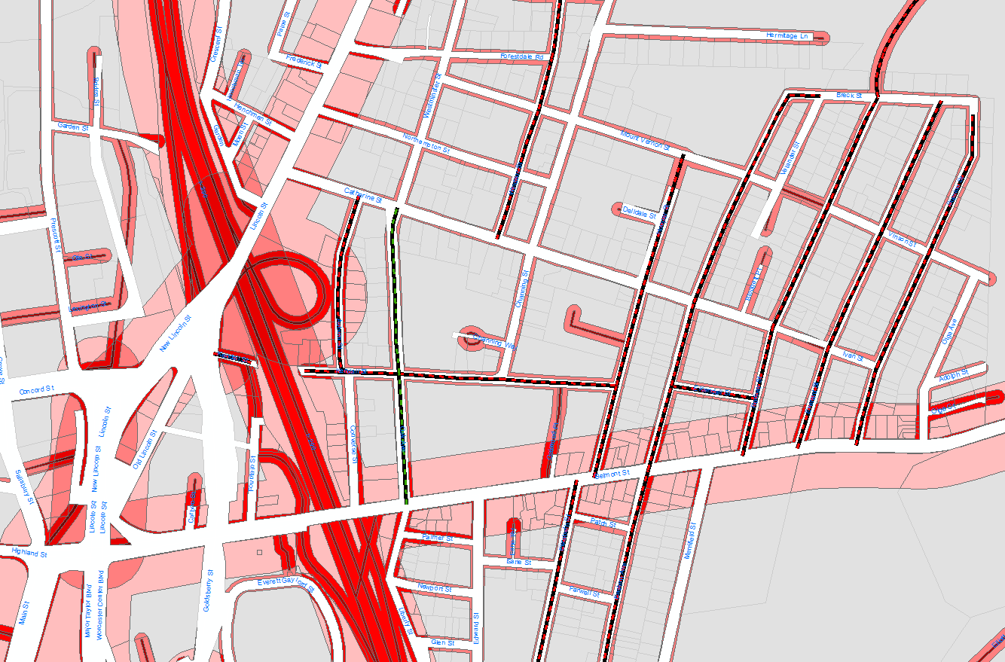
Contamination Outreach Map

Slide 15
So What?
I found that there is inconclusive data on any correlation between predicted leaded gas contamination and actual lead levels
We will further study and sample the area- focusing on the streets we know to have dangerous average Pb levels and in particular on the Kendall-Auburn area which is predicted to be exposed to multiple roadway contamination zones.
These maps will provide as walking maps for focused testing outreach, educational material on lead in Bell Hill, and as data for city remediation grants.

